Slide 1
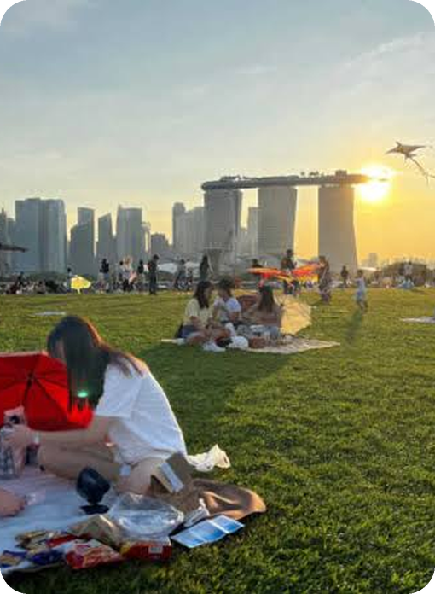

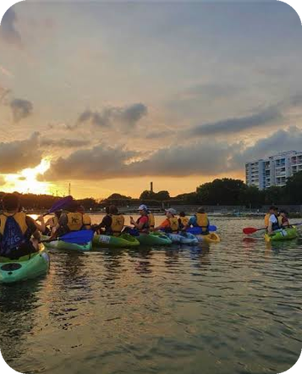
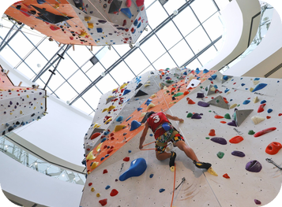
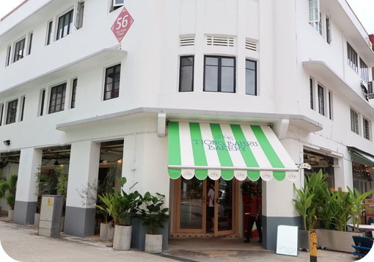

IS216 · G7 T3 · PROJECT PRESENTATION
Turn free time
into
plans.
Keen · 5
Discover things to do in Singapore, vote on them with your friends, find a time that works, and get an itinerary that fits.
PRESENTATION VIDEO
LIVE APP
Paste YouTube link
Paste app URL
Not keen · 1
Xin Hui · Meo Hui · Brendan · Wen Hsin · Emmanuel · Kin Yu
Notes:
TIME 0:00 to 0:20. Suggested speaker: Xin Hui (presentation lead).
Say: "Hi everyone, we're G7 Team 3 and this is WAD2Do, a web app that takes a group of friends from 'let's meet this weekend' to an agreed itinerary."
TO DO BEFORE RECORDING: replace the two dashed boxes with the real YouTube link (unlisted or public) and the live Vercel URL. The briefing requires both on this first slide.

Slide 2
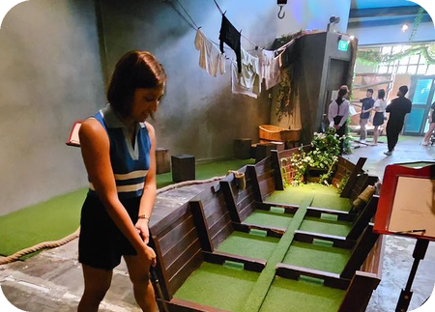
THE PROBLEM
Finding things to do is scattered.
Getting everyone to agree is harder.
01
02
03
Young working adults use multiple online platforms just to discover where to eat.
Affordability and convenient locations shape which recreation people choose.
In a group, everyone’s preferences and the travel involved decide the outing.
Leu et al. (2023), Appetite
URA (2026), More recreation closer to homes
Jin, Bansal & Axhausen (2025), Transportation Research Part A
Finding suitable activities and coordinating outings means juggling chat threads, polls and map apps. It is time-consuming.
SO WHAT
WAD2Do IS216 · G7 T3
02
Notes:
TIME 0:20 to 1:10. Suggested speaker: Xin Hui.
Say: Finding things to do isn't the problem. Planning with a group is. The research we cited backs three pieces of it: young adults hop across several platforms to discover places (Leu et al., 2023); affordability and convenient locations matter for recreation (URA, 2026); and in a group, everyone's preferences and the travel involved drive the decision (Jin et al., 2025).
Result: planning an outing becomes a chore spread over chat threads, polls and map apps. We don't have user surveys, so don't claim any numbers beyond these three sources.

Slide 3
OUR SOLUTION
WHY IT HELPS
One app. Five steps.
One agreed plan.
One place instead of chat threads, polls and map apps
Everyone’s votes and free time shape the plan
Real limits respected: budget, hours, travel, rain
1
2
3
Discover
4
Share
5
Activities ranked by your interests, budget and home area.
Vote
Send the ones you like to a group you’re in.
Pick a time
Keen or not keen. One vote each, live for everyone.
Plan
Mark when you’re free. The heatmap shows when most can go.
One tap builds a timeline that fits time, budget, hours and travel.
Activities page
Group · Activities
Group · Activities
Group · Availability
Group · Itinerary
WAD2Do IS216 · G7 T3
03
Notes:
TIME 1:10 to 2:00. Suggested speaker: Kin Yu.
Say: WAD2Do follows the order a group naturally plans in. You discover activities ranked for you, share the ones you like to a group, everyone votes keen or not keen, you mark when you're free on a heatmap, and then you press Plan and get an editable itinerary.
Point out that votes and availability update live for every member (Supabase Realtime), and that amber is the app's "do this" colour, which is why Plan is amber here.

Slide 4
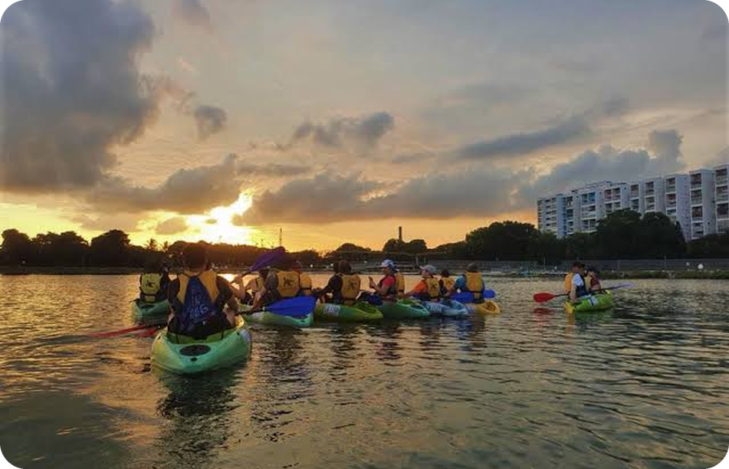
LIVE DEMO
1
Landing, sign up, log in
Emmanuel
Let’s plan an outing,
start to finish.
2
Onboarding and profile
Xin Hui
3
Browse, filter and share activities
Brendan
4
Create a group and vote
Kin Yu
5
Mark availability, press Plan
Meo Hui
6
Itinerary: weather, travel, edits
Wen Hsin
Resized live: phone to desktop
WAD2Do IS216 · G7 T3
04
Notes:
TIME 2:00 to 6:30 (about 4.5 minutes, roughly 45 seconds each). Switch to the browser.
This is a relay so every member presents, in the order a real group uses the app. Suggested owners come from the proposal: Emmanuel (landing, sign up, log in), Xin Hui (onboarding, profile), Brendan (activities), Kin Yu (groups, voting), Meo Hui (availability, Plan), Wen Hsin (itinerary).
Demo rules from the briefing: use Chrome, and drag the window narrower during the demo (phone width to wide desktop) to show the app is responsive. Have a dummy account and a group with a few votes ready so Plan runs without waiting. If one member is missing, merge their step into a neighbour.

Slide 5
UNDER THE HOOD · FRONT END
Vue for the logic, Bootstrap for the layout,
one theme for the look.
Dynamic
Styled
Responsive
VUE 3 + VUE ROUTER
BOOTSTRAP 5 + DESIGN TOKENS
PHONE TO DESKTOP
v-for draws activity cards from one reusable component
v-model filters and search update results instantly
computed properties sort votes and rank best matches
Supabase Realtime pushes votes and availability to everyone
Every colour, radius and shadow is a CSS variable in one file
Light “Brunch Club” and dark “Supper Club” modes from the same tokens
Amber is only ever the one thing to tap
Bootstrap grid and breakpoints on every page
Built and checked from iPhone 6 width up to the XL breakpoint
Visible keyboard focus and reduced-motion support
OUR PALETTE
Aa
Bricolage Grotesque
and type
for headings, with Manrope for everything else
Page
Card
Ink
Action
Keen
Not keen
WAD2Do IS216 · G7 T3
05
Notes:
TIME 6:30 to 7:20. Suggested speaker: Emmanuel (design/UI owner).
Cover the three things the rubric asks about the front end:
1. JavaScript makes it dynamic: Vue's v-for, v-model and computed power the cards, filters and vote sorting, and Realtime pushes changes in.
2. CSS: Bootstrap 5 for layout, plus our own tokens so colours, corners and shadows come from one file. Dark mode comes for free from the same names.
3. Responsive: checked from iPhone 6 width up to the XL breakpoint, which is how the markers will test it in Chrome dev tools.
All these libraries are free and public, so say so (credits are on the team slide).

Slide 6
UNDER THE HOOD · DATA STORE
One backend: Supabase.
Postgres is our data store. Edge Functions keep API keys off the browser.
Google Places
Supabase
Edge Functions
Google Places, OneMap
Vue app
OneMap routing
Vue 3 + Bootstrap 5
hosted on Vercel
Postgres
10 tables: activities, groups, votes…
STB Tourist Attractions
Auth
email sign-up and login
imported once
Realtime
live votes and availability
data.gov.sg weather
Storage
photos for submitted activities
called straight from the browser
WAD2Do IS216 · G7 T3
06
Notes:
TIME 7:20 to 8:05. Suggested speaker: Meo Hui (database owner).
State the data store clearly, as the briefing asks: Supabase Postgres, 10 tables (profiles, activities, groups, group_members, group_activities, votes, availability, itineraries, favourites, submissions). Also: Supabase Auth for login, Realtime for live votes and availability, Storage for submitted activity photos.
Edge Functions (google-place-search, google-place-details, onemap-route) sit between the browser and Google/OneMap so keys and tokens never reach the browser. The weather call goes straight from the browser because that API is open. The STB dataset was imported into the activities table once.

Slide 7
UNDER THE HOOD · EXTERNAL APIS
Four outside data sources,
each used for a reason.
EDGE FUNCTION
EDGE FUNCTION
DATASET IMPORT
BROWSER FETCH
Google Places
OneMap routing
STB Tourist Attractions
data.gov.sg weather
WHAT FOR
WHAT FOR
WHAT FOR
WHAT FOR
Search and live details: rating and opening hours.
Real travel time between two stops.
The seed list of Singapore attractions.
A rain check for the plan’s date.
HOW
HOW
HOW
HOW
google-place-search and google-place-details.
onemap-route keeps the token on the server.
data.gov.sg dataset imported into our activities table.
fetch() to the 4-day outlook endpoint.
WHAT WE HANDLED
WHAT WE HANDLED
WHAT WE HANDLED
WHAT WE HANDLED
Terms allow storing only the place_id, so details are fetched live.
Returns MRT, bus, transit, walk and cycle options. Stops that overrun are skipped.
It has no prices or categories, so we curate those ourselves.
Showers mean indoor swaps. Later dates say “Forecast not available yet”.
WAD2Do IS216 · G7 T3
07
Notes:
TIME 8:05 to 8:50. Suggested speaker: Brendan (data and API owner).
Briefing asks you to name each external API and give brief integration details. One line each:
- Google Places: via Edge Functions, we store only the place_id (Google's terms) and fetch rating and hours live.
- OneMap: via the onemap-route Edge Function so the token is private; returns five travel options per leg.
- STB Tourist Attractions: imported once from data.gov.sg; no prices or categories, so we filled those ourselves.
- data.gov.sg 4-day weather: fetched from the browser for the plan's date; showers trigger indoor swaps; beyond four days the timeline says "Forecast not available yet".

Slide 8
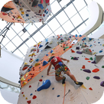
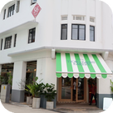

OUR OWN LOGIC
How Plan builds
an itinerary
Itinerary
Illustrative
10:00
Climb Central
11:30
4 votes in the group
1
Start with the group’s voted activities, highest net votes first.
18 min by MRT
2
Add a stop only if it fits the chosen time slot and the remaining budget.
11:50
Tiong Bahru cafes
13:20
3 votes in the group
3
Ask OneMap how long the trip from the previous stop takes.
4
Check the place is open for the whole visit.
25 min by bus
13:45
National Gallery
5
Save the plan. If showers are forecast, outdoor stops get indoor swaps.
15:30
2 votes · indoor swap if showers
BEST MATCH ON THE ACTIVITIES PAGE
Each stop is checked against opening hours and budget as you edit.
Interest +4
Budget +2
Your area +1
WAD2Do IS216 · G7 T3
08
Notes:
TIME 8:50 to 9:35. Suggested speaker: Meo Hui (Plan function).
This is the part that goes beyond the minimum, and it is a function we wrote ourselves, not a library. The planner sorts the group's voted activities by net votes, then walks down the list adding each one only if: it fits the time left in the chosen slot, it fits the remaining budget per person, the OneMap travel time from the last stop still fits, and the place is open for the full visit. Each stop stores a reason ("N votes in the group"). If showers are forecast for that date, outdoor stops get an indoor alternative from activities the group already voted for.
The mini itinerary on the right is an ILLUSTRATIVE EXAMPLE drawn for this slide (times, travel legs and names are made up). Swap it for a real screenshot of your Itinerary tab if you have one.
Bottom chips: the Activities page "Best match" score is interest match +4, under budget +2, same area +1 (from activityRanking.js).

Slide 9
BEYOND THE MINIMUM
Extras we built because
a real group would need them.
Live updates
Private API keys
Our own planner
Votes and availability appear for every member instantly, no refresh.
Google Places and OneMap are called from the server, never the browser.
Builds the itinerary from votes, time, budget, hours and travel.
Supabase Realtime
Supabase Edge Functions
Written by us in JavaScript
Two themes
Community activities
Easy joining
Light Brunch Club and dark Supper Club, plus seasonal navbars.
Anyone can submit a place with a photo; admins approve or reject it.
Join a group by invite link, short code or QR code.
CSS design tokens
Supabase Storage
qrcode library
WAD2Do IS216 · G7 T3
09
Notes:
TIME 9:35 to 10:15. Suggested speaker: Kin Yu.
The briefing asks you to mention technologies beyond the minimum. Go quickly, one sentence each:
- Realtime: votes and availability update live for everyone (Supabase Realtime channels on the votes, group_activities and availability tables).
- Edge Functions: Google Places and OneMap keys stay on the server.
- Our planner: the Plan algorithm on the previous slide is our own code.
- Themes: light and dark modes from the same CSS tokens, plus seasonal navbar themes (New Year, National Day, Halloween, Christmas).
- Community submissions: photo upload to Supabase Storage, admin review with approve/reject, approved ones get a "Community" badge.
- Joining: invite link, 6-character code or QR code (qrcode library).

Slide 10
QUALITY
Tested, versioned and live.
200+
12
50+
end-to-end test cases
unit and database test files
pull requests merged
Playwright, 17 spec files covering every core flow.
Ranking, opening hours, Google Places, groups and more.
Feature branches merged on GitHub: 180+ commits across 22 branches.
Deployed on Vercel
Keys stay private
Stable selectors
Try it yourself: the live link is on the first slide.
Google and OneMap calls run in Edge Functions, not the browser.
Every element a test touches has a data-testid.
WAD2Do IS216 · G7 T3
10
Notes:
TIME 10:15 to 10:50. Suggested speaker: Wen Hsin (testing owner).
Numbers come from the repo as of Nov 3: 17 Playwright spec files with about 237 test cases (we say "200+" so it stays true), 12 unit/database test files in /tests, 52 merged pull requests (up to PR #53), 181 commits and 22 branches. Re-count the day before you submit and update the slide if you pass a round number.
GitHub collaboration is a minimum requirement, so say it out loud: "Each feature was built on its own branch and merged through a pull request."
Mention how to run them: pnpm run test:e2e (it's in the README).
Only say "Deployed on Vercel" once the app is actually live, and add the URL to slides 1 and 11 and to README.txt (the briefing requires it there too). Briefing rubric rewards tests that are repeatable, use stable selectors, and have clear README instructions.

Slide 11
THE TEAM
Six people, six areas,
one product.
Xin Hui
Meo Hui
Brendan
DEPLOYMENT · PRESENTATION LEAD
DATABASE OWNER
DATA AND API OWNER
Onboarding · Profile
Group availability heatmap · Plan function
Activities page · Activity detail
Wen Hsin
Emmanuel
Kin Yu
TESTING OWNER
DESIGN AND UI OWNER
GITHUB · DEADLINES
Group itinerary: timeline, weather swaps, edits
Landing · Sign up · Log in · Submit · Admin review · Navbar
Groups · Group activities tab with live voting
BUILT WITH FREE PUBLIC LIBRARIES Vue 3 · Vue Router · Vite · Bootstrap 5 · Supabase JS · qrcode · Playwright · Bricolage Grotesque and Manrope (Google Fonts)
WAD2Do IS216 · G7 T3
11
Notes:
TIME 10:50 to 11:25. Suggested speaker: Xin Hui.
Quick roll call so every member is named with what they built. Roles and pages are taken straight from the project proposal and progress pitch.
The briefing requires free libraries to be identified in the presentation (and in code comments), so the strip along the bottom does that. Add anything else you installed. If you used AI tools (the course allows it for lower-order tasks only), state which parts in README.txt as the briefing requires. The photos in the app are curated activity images: make sure you can say where they came from if asked.

Slide 12

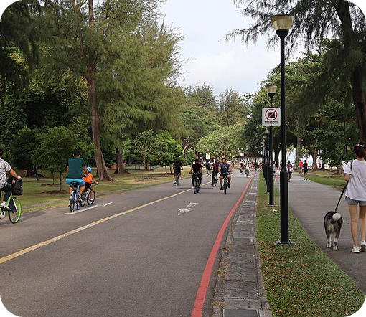
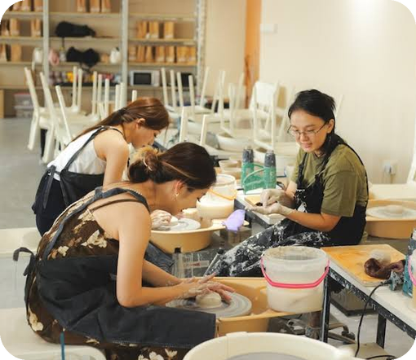
Thank you.
Questions?
Keen · 6
Discover · Share · Vote · Pick a time · Plan
PRESENTATION VIDEO
LIVE APP
Paste YouTube link
Paste app URL
WAD2Do IS216 · G7 T3
12
Notes:
TIME 11:25 to 12:00. Suggested speaker: Everyone, then Xin Hui closes.
Say: "Thanks for watching. WAD2Do takes a group from 'let's meet this weekend' to an agreed itinerary in one app." For the live session you then have 3 minutes of Q&A. Keep this slide up during Q&A.
Same two link boxes as slide 1: replace with the real YouTube and app URLs.
Likely questions to rehearse: how Plan handles a clash of opening hours or budget; why only place_id is stored for Google Places; how Realtime works; what happens beyond the 4-day forecast; how you tested; who did what.

Slide 13
APPENDIX
References and data sources
RESEARCH
Jin, Z., Bansal, P., & Axhausen, K. W. (2025). A novel approach to study the role of social networks in planning joint leisure activities. Transportation Research Part A: Policy and Practice, 192, 104371. https://doi.org/10.1016/j.tra.2024.104371
Leu, J., Rebello, S. A., Sargent, G. M., Kelly, M., & Banwell, C. (2023). The Singaporean foodscape: Convenience, choice, entertainment, and sociality for young workers. Appetite, 189, 106992. https://doi.org/10.1016/j.appet.2023.106992
Urban Redevelopment Authority. (2026, June 24). More recreation closer to homes. https://www.ura.gov.sg/land-planning/long-term-plan/space-for-our-dreams-exhibition/play/more-recreation/
DATA AND APIS
Tourist Attractions dataset
Singapore Tourism Board via data.gov.sg
data.gov.sg/datasets/d_0f2f47515425404e6c9d2a040dd87354
4-day weather outlook API
data.gov.sg (NEA)
api-open.data.gov.sg/v2/real-time/api/four-day-outlook
Places API
Google Maps Platform
developers.google.com/maps/documentation/places
Routing API
OneMap (Singapore Land Authority)
onemap.gov.sg/apidocs/routing
WAD2Do IS216 · G7 T3
13
Notes:
Appendix, not presented. It's here so markers reading the PDF can see full references for the problem slide and every data source. Keep the "Thank you / Questions?" slide on screen during Q&A.

